Slide 1
TEXT SIMILARITY CHECKERS
BY
PITCHUMANI M

Slide 2
PROBLEM STATEMENT
The challenge in text analysis is accurately measuring similarity between two texts for applications like plagiarism detection and document comparison. Existing methods often lack efficiency or fail to capture different aspects of similarity. This project implements multiple algorithms to provide a comprehensive and efficient approach to text similarity measurement.

Slide 3
The Text Similarity Analyzer is a Java-based tool that computes similarity between two texts using multiple algorithms.
It employs Jaccard Similarity, Cosine Similarity, and Dice Coefficient for set-based and vector-based similarity analysis.
Additionally, it calculates Levenshtein Distance to measure edit distance, and Longest Common Subsequence (LCS) to find shared character sequences. The program tokenizes input text, computes word frequencies, and evaluates similarity scores efficiently.
This tool is useful in plagiarism detection, document comparison, and natural language processing (NLP). The results provide a comprehensive understanding of textual resemblance, making it valuable for researchers and developers in the field of text analytics.
ABSTRACT

Slide 4
Text similarity plays a crucial role in various applications, including plagiarism detection, document comparison, and Natural Language Processing (NLP).
This project implements multiple similarity measurement techniques, such as Jaccard Similarity, Cosine Similarity, and Levenshtein Distance, to provide an efficient and comprehensive approach for analyzing and comparing textual data accurately.
INTRODUCTION

Slide 5
Dashti et al. (2024) proposed an automatic real-word error correction system for Persian text using neural computing applications. Their method focuses on detecting and correcting real-word errors that traditional spell-checkers often miss. By leveraging machine learning techniques, their approach enhances text quality and readability, particularly in Persian language processing.
LITERATURE
SURVEY

Slide 6
Shipurkar et al. (2023) developed an end-to-end system for handwritten text recognition and plagiarism detection using Convolutional Neural Networks (CNNs) and Bidirectional Long Short-Term Memory (BLSTM) networks. Their study demonstrates the effectiveness of deep learning models in processing handwritten documents and detecting textual similarities, which is crucial for academic and research-based plagiarism detection.
LITERATURE
SURVEY

Slide 7
Panchal and Shah (2024) implemented Norvig’s algorithm for spell-checking in Gujarati text. Their research addresses challenges in low-resource language processing, ensuring efficient text correction and enhanced accuracy. This approach improves text preprocessing for Gujarati-based applications such as document processing and machine translation.
LITERATURE
SURVEY

Slide 8
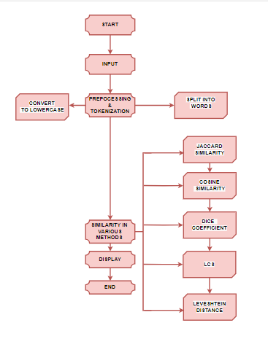
FLOW CHART
The flowchart illustrates the workflow of a Java-based text similarity checker, starting with the "Start" node and proceeding to the "Input" stage, where two text strings are provided.
The next step is "Preprocessing & Tokenization," which is divided into two processes: "Convert to Lowercase" to ensure case insensitivity and "Split into Words" for tokenization.
After preprocessing, the system calculates similarity using different methodologies under "Similarity in Various Methods." These methods include Jaccard Similarity, Cosine Similarity, Dice Coefficient, Longest Common Subsequence (LCS), and Levenshtein Distance, each measuring similarity based on different criteria such as set-based, vector-based, and edit distance approaches.
Finally, the results are displayed, and the process ends. This structured approach ensures a comprehensive text similarity analysis using multiple techniques.

Slide 9
APPLICATION
Plagiarism detection
Document comparison
Natural Language Processing (NLP)

Slide 10
ADVANTAGES
Multiple Similarity Metrics
Efficient Text Processing
Versatile Applications
Accuracy

Slide 11
Future Benefits
Enhanced Plagiarism Detection
Advanced NLP Applications
Automated Document Comparison
Machine Learning Integration
Multilingual Support
Real-time Processing

Slide 12
CONCLUSION
The Text Similarity Analyzer is an effective tool for measuring similarity between texts using multiple techniques.
It is valuable for applications like plagiarism detection and document analysis.
However, while it provides precise numerical scores, it does not capture semantic meaning, making it best suited for syntactic rather than deep contextual comparisons.

Slide 13
Thank you

